Slide 1
Ai-powered Study ASSISTANT
Sector: education
Team members: Lukhona Dukuza; Iviwe Hlatana; Caleigh goliath

Slide 2
Sector overview
AI is transforming education.
Focus areas: personalized learning, tutoring, content creation.
Our project explores how AI can help students study more effectively.

Slide 3
Existing AI APPLICATIONS IN EDUCATION
1. Duolingo – AI-driven language learning.
- Uses ML to personalize lessons.
-Adapts exercises based on user performance.
2. Quizlet – Flashcards and quizzes powered by AI.
-Uses AI to suggest relevant practice questions.
- Allows students to generate customized quizzes from study material.
3. Socratic by Google – AI tutor that explains problems step-by-step.
- Uses computer vision and NLP to interpret questions
- Provides step-by-step explanations and guided learning

Slide 4
Problem statement
Students struggle to summarize and revise large volumes of notes.
Limited access to personalized study support.
Impact metric: Improved retention and reduced study time.

Slide 5
Proposed solution
Study Assistant Chatbot (built with Botpress).
Users paste notes into the chatbot.
Bot can:
  Summarize notes.
  Explain concepts.
  Generate interactive quizzes.

Slide 6
LIVE DEMO
LINK TO STUDY ASSISTANT: https://cdn.botpress.cloud/webchat/v3.2/shareable.html?configUrl=https://files.bpcontent.cloud/2025/08/27/09/20250827091647-NHHTAVQZ.json
Paste notes into the chatbot.
Ask it to Summarize, Explain, or Generate a Quiz.
See real-time outputs:
  Summaries with glossary
  Explanations with analogies
  Multiple-choice quizzes with feedback

Slide 7
Data input and processing
Data Input: User-pasted text.
AI Processing:
o Summarization → 2 paragraphs + bullet points.
o Explanation → Definitions, analogies, steps.
o Quiz → Multiple-choice questions with feedback.

Slide 8
User-friendly output
Summaries: Clear and concise.
Explanations: With analogies + practice questions.
Quizzes: Multiple choice, one question at a time, with feedback.

Slide 9
Error handling
Gibberish input → “I do not understand…”
Off-topic questions → “Please ask something related to the notes.”

Slide 10
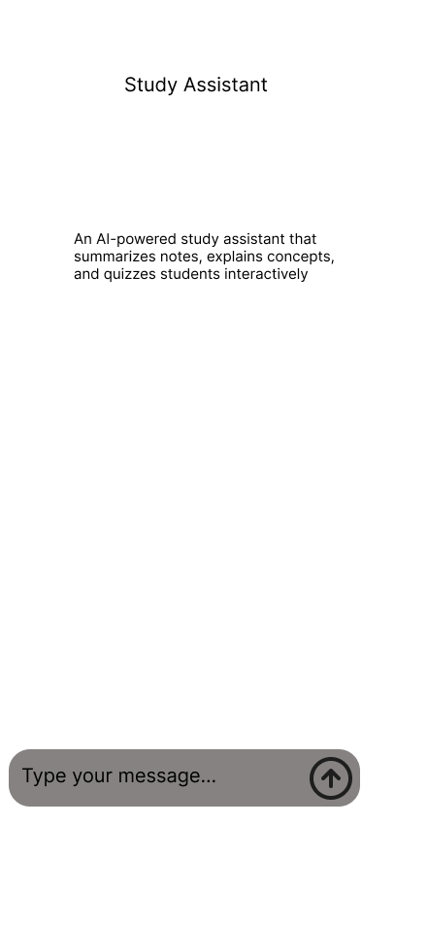
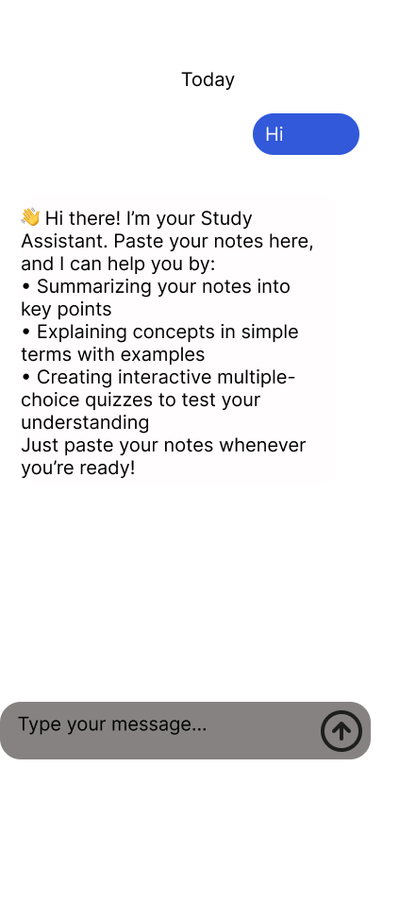
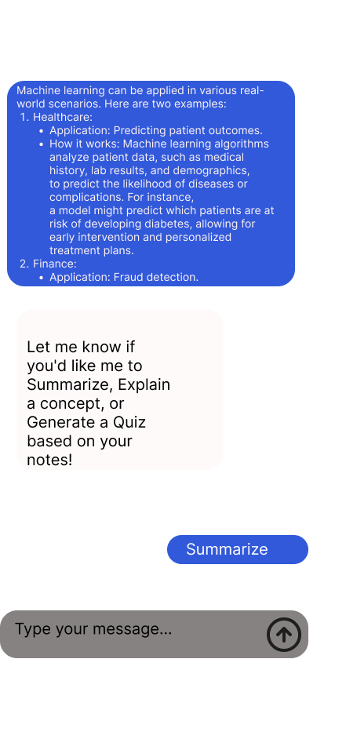
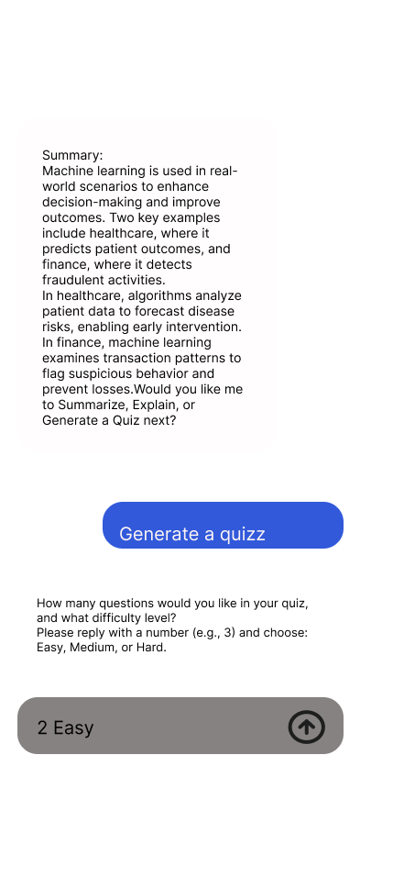
User interaction flow

Slide 11
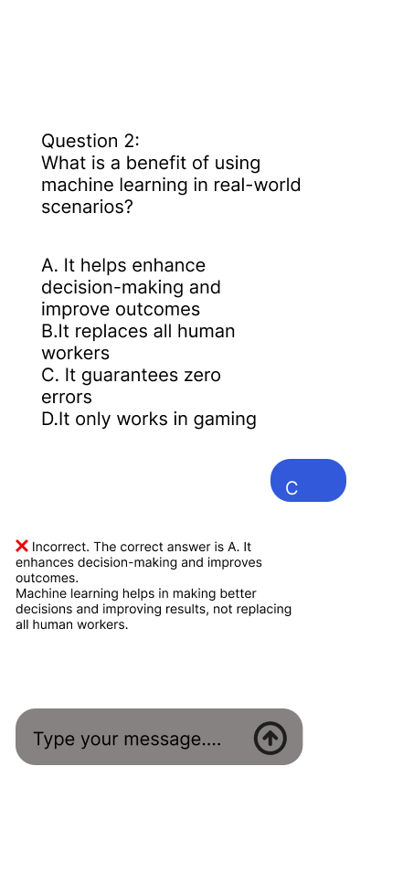
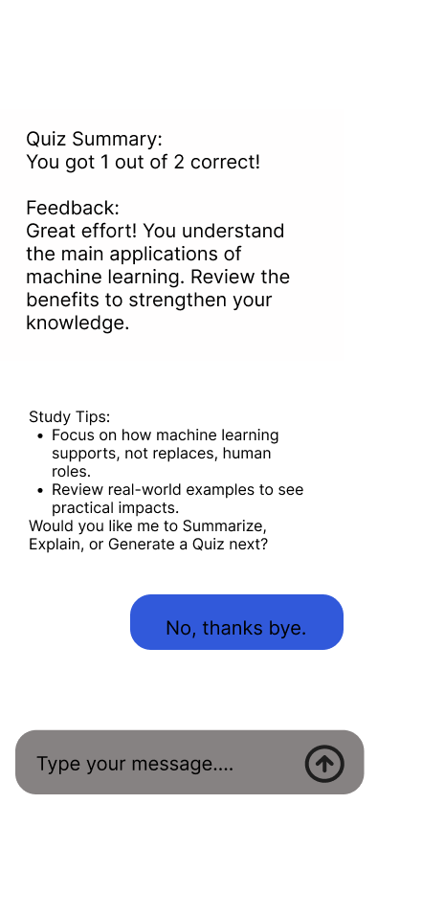
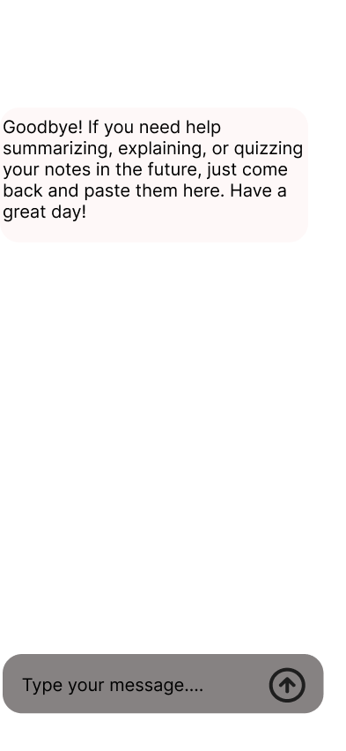
USER INTERACTION FLOW

Slide 12


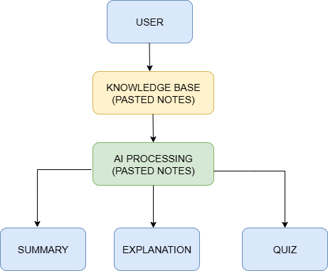
Data Flow Diagram
Data Flow Diagram: User → Bot → Notes → AI Processing → Output

Slide 13
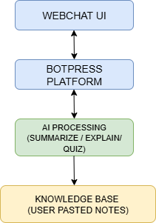
System Architecture diagram
System Architecture: Webchat UI, Botpress platform, Knowledge Base, AI engine

Slide 14
Conclusion & Future Improvements
Achievements: Functional study assistant prototype with interactive summaries, explanations, and quizzes.
Future improvements: PDF uploads, adaptive difficulty, enhanced UI.

Slide 15

Q&a

